Slide 1
3
Matrices

Slide 2
3.1
Matrix Operations

Slide 3
Matrix Operations (1 of 5)
Definition
A matrix is a rectangular array of numbers called the entries, or elements, of the matrix.
The size of a matrix is a description of the numbers of rows and columns it has. A matrix is called m × n (pronounced “m by n”) if it has m rows and n columns.
A 1 × m matrix is called a row matrix (or row vector), and an n × 1 matrix is called a column matrix (or column vector).

Slide 4
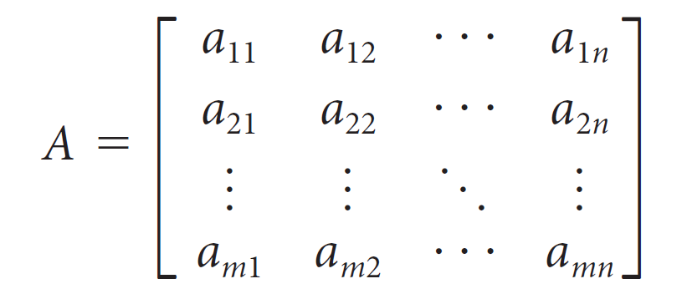
Matrix Operations (2 of 5)
We use double-subscript notation to refer to the entries of a matrix A. The entry of A in row i and column j is denoted by a_{ij}.
With this notation, a general m × n matrix A has the form

Slide 5
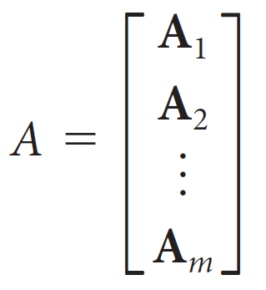
Matrix Operations (3 of 5)
If the columns of A are the vectors a₁, a₂, ..., a_{n}, then we may represent A as
A = [a₁ a₂ ... a_{n}]
If the rows of A are A₁, A₂, ..., A_{m}, then we may represent A as

Slide 6
Matrix Operations (4 of 5)
The diagonal entries of A are a₁₁, a₂₂, a₃₃, . . . , and if m = n
(that is, if A has the same number of rows as columns), then
A is called a square matrix.
A square matrix whose nondiagonal entries are all zero is called a diagonal matrix.
A diagonal matrix all of whose diagonal entries are the same
is called a scalar matrix. If the scalar on the diagonal is 1,
the scalar matrix is called an identity matrix.

Slide 7
Matrix Operations (5 of 5)
Two matrices are equal if they have the same size and if
their corresponding entries are equal.
Thus, if A = [a_{ij}]_{m × n} and B = [b_{ij}]_{r × s}, then A = B if and only if m = r and n = s and a_{ij} = b_{ij} for all i and j.

Slide 8
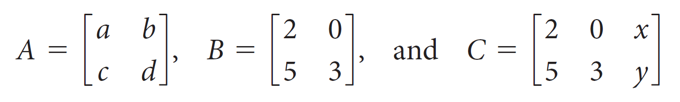
Example 3.1
Consider the matrices
Neither A nor B can be equal to C (no matter what the values of x and y), since A and B are 2 × 2 matrices and C is 2 × 3. However, A = B if and only if a = 2, b = 0, c = 5, and d = 3.

Slide 9
Matrix Addition and Scalar Multiplication

Slide 10
Matrix Addition and Scalar Multiplication (1 of 3)
If A = [a_{ij}] and B = [b_{ij}] are m × n matrices, their sum A + B is the m × n matrix obtained by adding the corresponding entries. Thus,
A + B = [a_{ij} + b_{ij}]
If A and B are not the same size, then A + B is not defined.

Slide 11
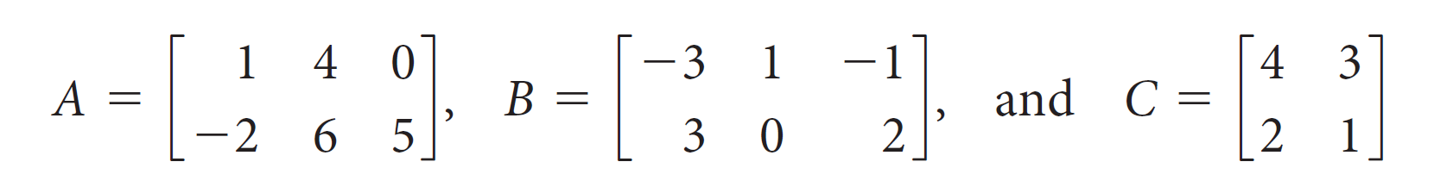
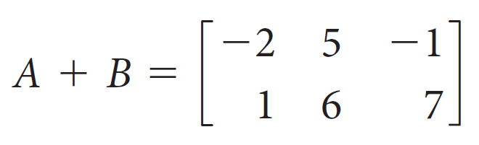
Example 3.3
Let
Then
but neither A + C nor B + C is defined.

Slide 12
Matrix Addition and Scalar Multiplication (2 of 3)
If A is an m × n matrix and c is a scalar, then the scalar
multiple cA is the m × n matrix obtained by multiplying each
entry of A by c. More formally, we have
cA = c[a_{ij}] = [ca_{ij}]
The matrix (−1)A is written as −A and called the negative of A. We can use this fact to define the difference of two matrices: If A and B are the same size, then
A − B = A + (−B)

Slide 13
Matrix Addition and Scalar Multiplication (3 of 3)
A matrix all of whose entries are zero is called a zero matrix and denoted by O or O_{m×n} .
If A is any matrix and O is the zero matrix of the same size, then
A + O = A = O + A
and
A − A = O = −A + A

Slide 14
Matrix Multiplication

Slide 15
Matrix Multiplication (1 of 6)
Definition
If A is an m × n matrix and B is an n × r matrix, then the product C = AB is an m × r matrix. The (i, j) entry of the product is computed as follows:
c_{ij} = a_{i1}b_{1j} + a_{i2}b_{2j} + ... + a_{in}b_{nj}
Notice that A and B need not be the same size. However, the number of columns of A must be the same as the number of rows of B.

Slide 16
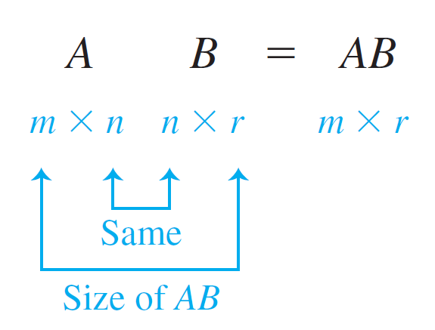
Matrix Multiplication (2 of 6)
The number of rows of AB is the same as the number of rows of A, while the number of columns of AB is the same as the number of columns of B, as shown below:

Slide 17
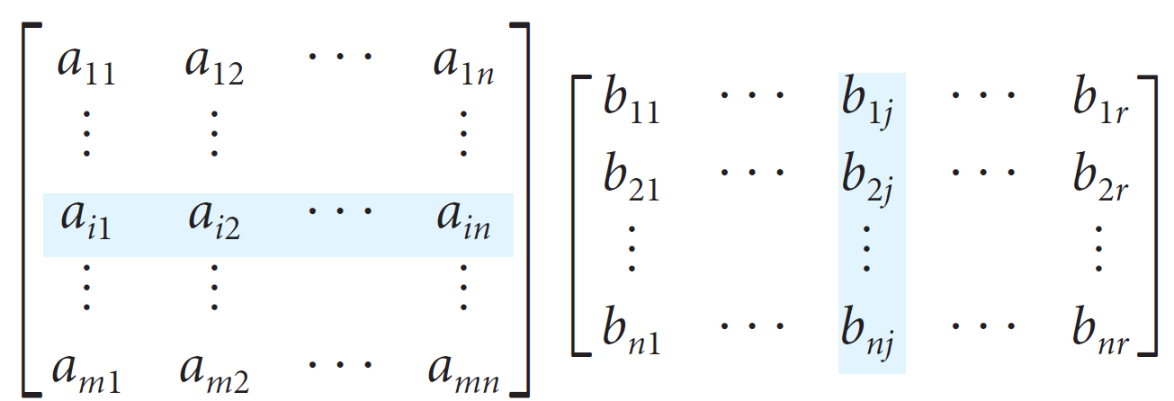
Matrix Multiplication (3 of 6)
The (i, j) entry of the matrix AB is the dot product of the ith row of A and the jth column of B:

Slide 18
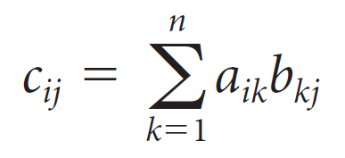
Matrix Multiplication (4 of 6)
Notice that, in the expression c_{ij} = a_{i1}b_{1j} + a_{i2}b_{2j} + ... + a_{in}b_{nj}, the “outer subscripts” on each ab term in the sum are always i and j whereas the “inner subscripts” always agree and increase from 1 to n. We see this pattern clearly if we write c_{ij} using summation notation:

Slide 19
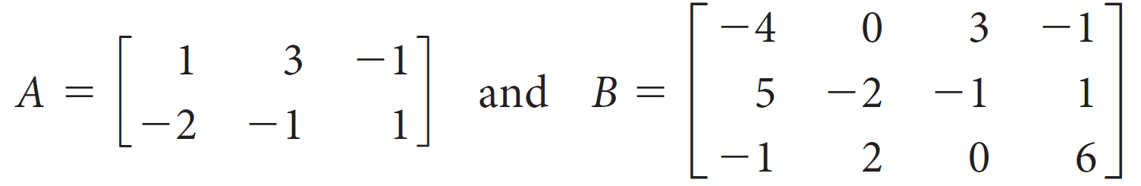
Example 3.6 (1 of 3)
Compute AB if
Solution:
Since A is 2 × 3 and B is 3 × 4, the product AB is defined and will be a 2 × 4 matrix. The first row of the product C = AB is computed by taking the dot product of the first row of A with each of the columns of B in turn.

Slide 20
Example 3.6 (2 of 3)
Thus,
c₁₁ = 1(−4) + 3(5) + (−1)(−1) = 12
c₁₂ = 1(0) + 3(−2) + (−1)(2) = −8
c₁₃ = 1(3) + 3(−1) + (−1)(0) = 0
c₁₄ = 1(−1) + 3(1) + (−1)(6) = −4
The second row of C is computed by taking the dot product of the second row of A with each of the columns of B in turn:
c₂₁ = (−2)(−4) + (−1)(5) + (1)(− 1) = 2

Slide 21
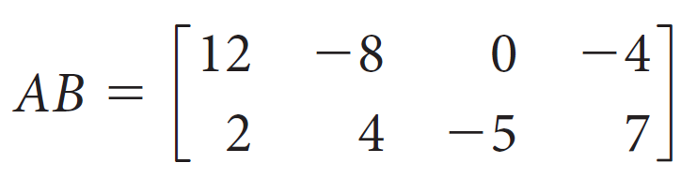
Example 3.6 (3 of 3)
c₂₂ = (−2)(0) + (−1)(−2) + (1)(2) = 4
c₂₃ = (−2)(3) + (−1)(−1) + (1)(0) = −5
c₂₄ = (−2)(−1) + (−1)(1) + (1)(6) = 7
Thus, the product matrix is given by

Slide 22

Matrix Multiplication (5 of 6)
Every linear system can be written in the form Ax = b. In fact, the notation
for the augmented matrix of a linear system is just shorthand for the matrix equation Ax = b.
There is another fact about matrix operations that will also prove to be quite useful: Multiplication of a matrix by a standard unit vector can be used to “pick out” or “reproduce” a column or row of a matrix.

Slide 23
Matrix Multiplication (6 of 6)
Theorem 3.1
Let A be an m × n matrix, e_{i} a 1 × m standard unit vector, and e_{j} an n × 1 standard unit vector. Then
a. e_{i} A is the ith row of A and
b. Ae_{j} is the jth column of A.

Slide 24
Partitioned Matrices

Slide 25
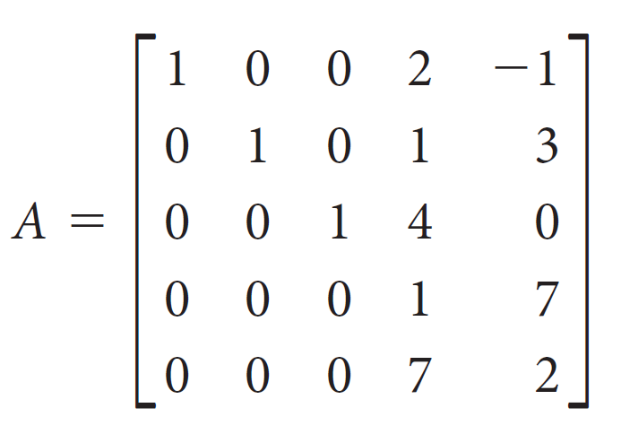
Partitioned Matrices (1 of 8)
It will often be convenient to regard a matrix as being composed of a number of smaller submatrices. By introducing vertical and horizontal lines into a matrix, we can partition it into blocks.
Consider the matrix

Slide 26
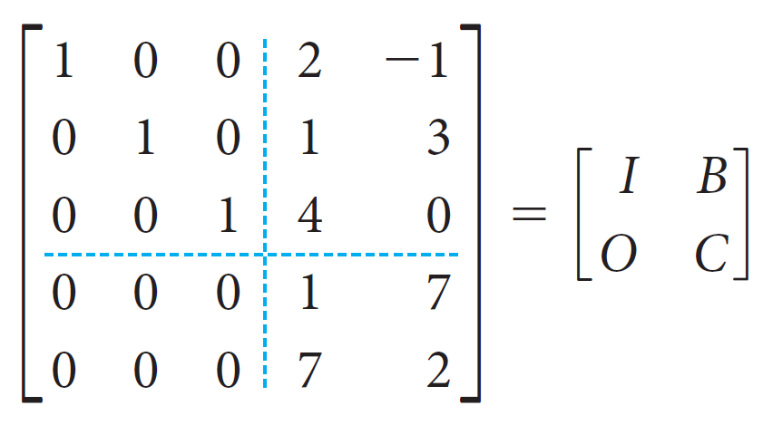
Partitioned Matrices (2 of 8)
It seems natural to partition A as
where I is the 3 × 3 identity matrix, B is 3 × 2, O is the 2 × 3 zero matrix, and C is 2 × 2. In this way, we can view A as a 2 × 2 matrix whose entries are themselves matrices.

Slide 27

Partitioned Matrices (3 of 8)
When matrices are being multiplied, there is often an advantage to be gained by viewing them as partitioned matrices.
Suppose A is m × n and B is n × r, so the product AB exists. If we partition B in terms of its column vectors, as
then

Slide 28
Partitioned Matrices (4 of 8)
This result is an immediate consequence of the definition of matrix multiplication. The form on the right is called the matrix-column representation of the product.

Slide 29
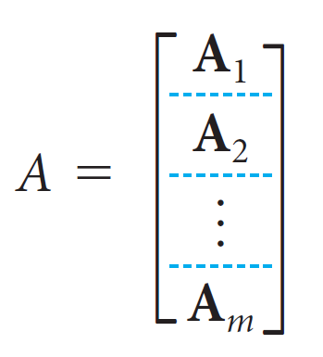
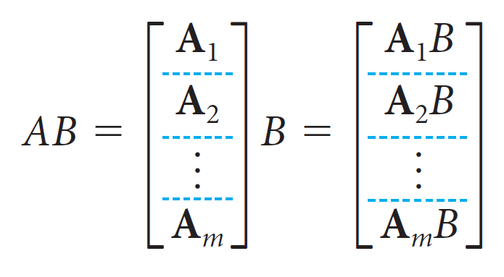
Partitioned Matrices (5 of 8)
Suppose A is m × n and B is n × r, so the product AB exists. If we partition A in terms of its row vectors, as
Then

Slide 30
Partitioned Matrices (6 of 8)
Once again, this result is a direct consequence of the definition of matrix multiplication. The form on the right is called the row-matrix representation of the product.
The definition of the matrix product AB uses the natural partition of A into rows and B into columns; this form might well be called the row-column representation of the product. We can also partition A into columns and B into rows; this form is called the column-row representation of the product.

Slide 31
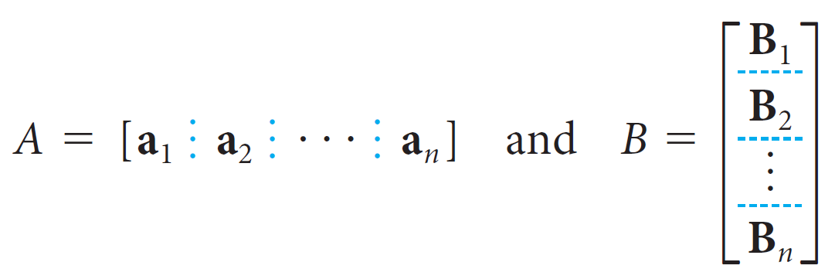
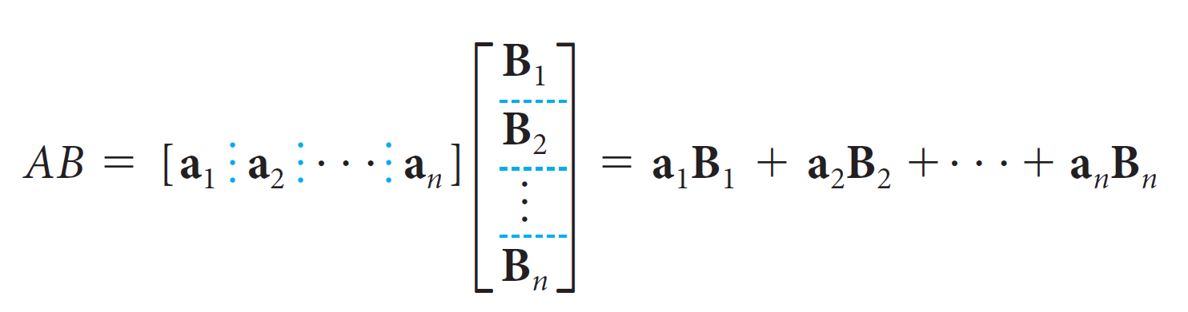
Partitioned Matrices (7 of 8)
In this case, we have
so
(2)

Slide 32
Partitioned Matrices (8 of 8)
Notice that the sum resembles a dot product expansion; the difference is that the individual terms are matrices, not scalars. Each term a_{i}B_{i} is the product of an m × 1 and a 1 × r matrix.
Thus, each a_{i}B_{i} is an m × r matrix—the same size as AB. The products a_{i}B_{i} are called outer products, and (2) is called the outer product expansion of AB.

Slide 33
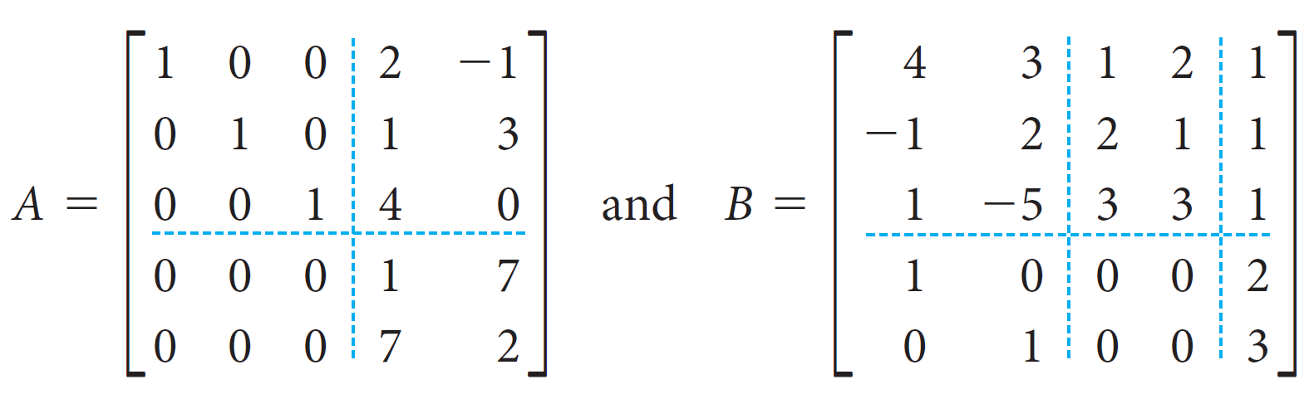
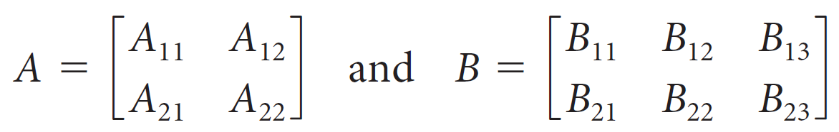
Example 3.12 (1 of 4)
Consider the partitioned matrices A and B as follows.
They have the block structures

Slide 34
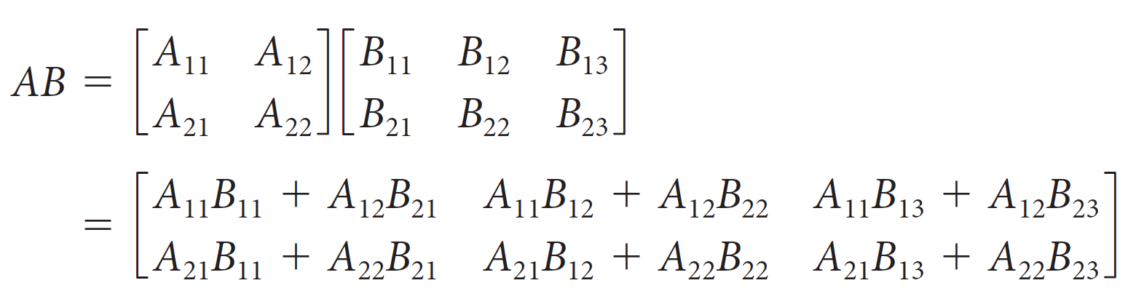
Example 3.12 (2 of 4)
If we ignore for the moment the fact that their entries are matrices, then A appears to be a 2 × 2 matrix and B a 2 × 3 matrix. Their product should thus be a 2 × 3 matrix given by
But all of the products in this calculation are actually matrix products, so we need to make sure that they are all defined.

Slide 35
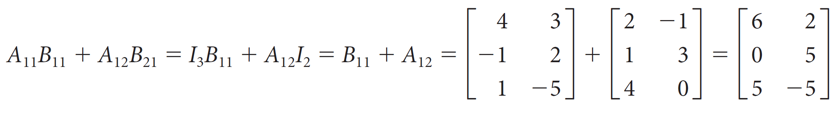
Example 3.12 (3 of 4)
A quick check reveals that this is indeed the case, since the numbers of columns in the blocks of A (3 and 2) match the numbers of rows in the blocks of B. The matrices A and B are said to be partitioned conformably for block multiplication.
Carrying out the calculations indicated gives us the product AB in partitioned form:

Slide 36
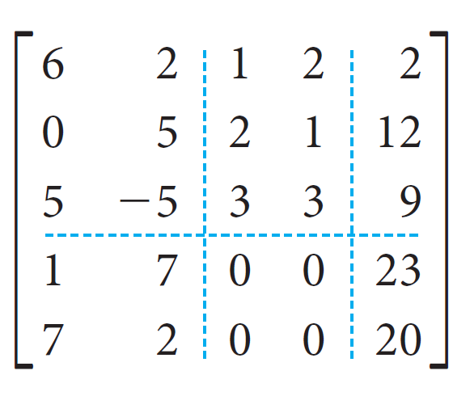
Example 3.12 (4 of 4)
The calculations for the other five blocks of AB are similar. Check that the result is

Slide 37
Matrix Powers

Slide 38


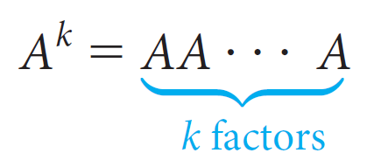


Matrix Powers (1 of 2)
When A and B are two n × n matrices, their product AB will also be an n × n matrix. A special case occurs when A = B. To define
as
and, in general, to define
if k is a positive integer. Thus,
and it is convenient to
define

Slide 39
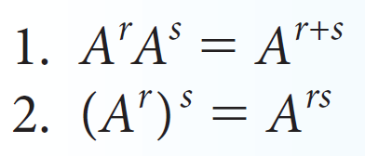
Matrix Powers (2 of 2)
The following properties follow immediately from the definitions.
If A is a square matrix and r and s are nonnegative integers, then

Slide 40
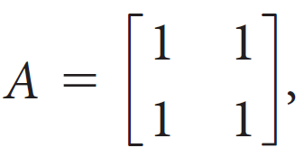
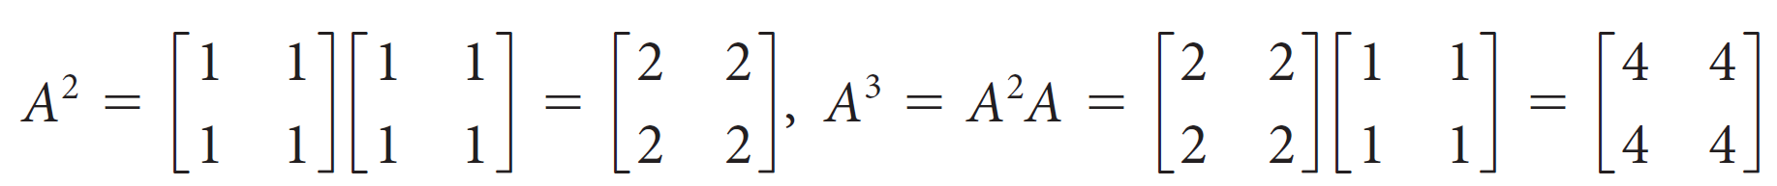
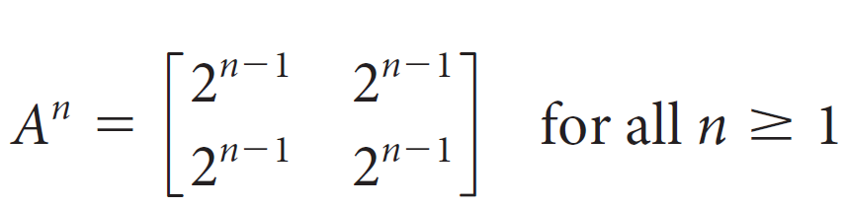
Example 3.13 (1 of 5)
(a) If
then
and, in general,
The above statement can be proved by mathematical induction, since it is an infinite collection of statements, one for each natural number n.

Slide 41
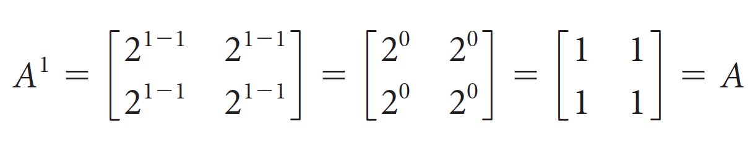
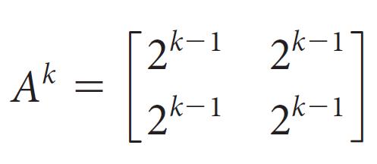
Example 3.13 (2 of 5)
The basis step is to prove that the formula holds for n = 1. In this case,
as required.
The induction hypothesis is to assume that
for some integer k ≥ 1. The induction step is to prove that the formula holds for n = k + 1.

Slide 42
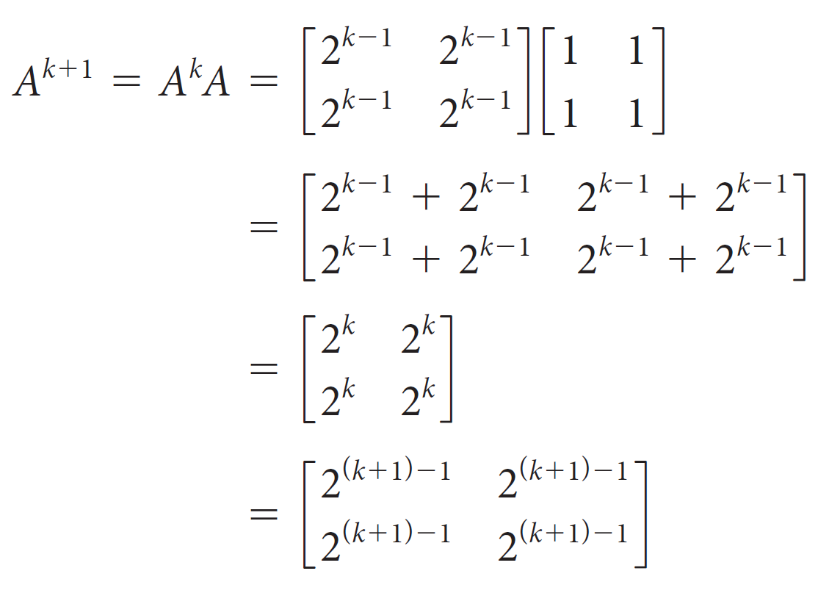
Example 3.13 (3 of 5)
Using the definition of matrix powers and the induction hypothesis, we compute
Thus, the formula holds for all n ≥ 1 by the principle of mathematical induction.

Slide 43
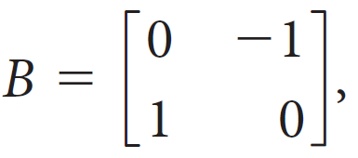
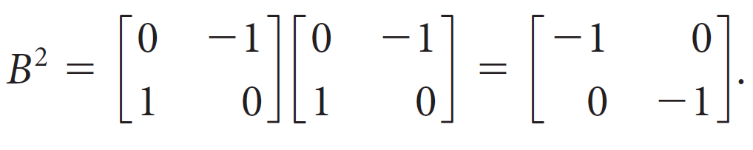
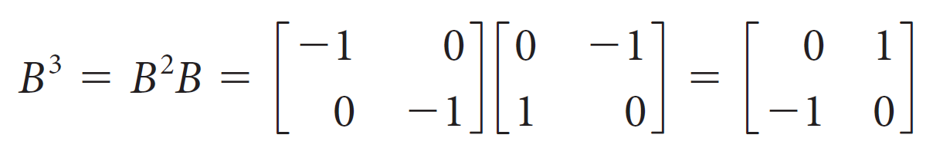
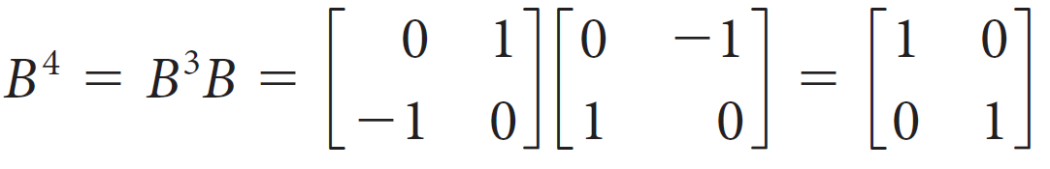
Example 3.13 (4 of 5)
(b) If
then
Continuing, we find
and

Slide 44
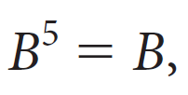
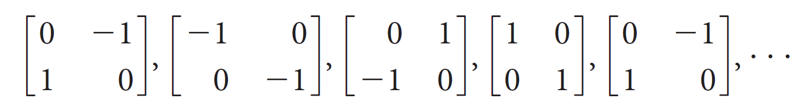
Example 3.13 (5 of 5)
and the sequence of powers of B repeats in a cycle of four:
Thus,

Slide 45
The Transpose of a Matrix

Slide 46

The Transpose of a Matrix (1 of 3)
Definition
The transpose of an m × n matrix A is the n × m matrix
obtained by interchanging the rows and columns of A. That
is, the ith column of
is the ith row of A for all i.

Slide 47
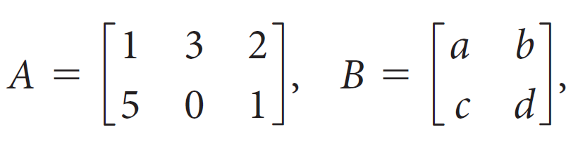
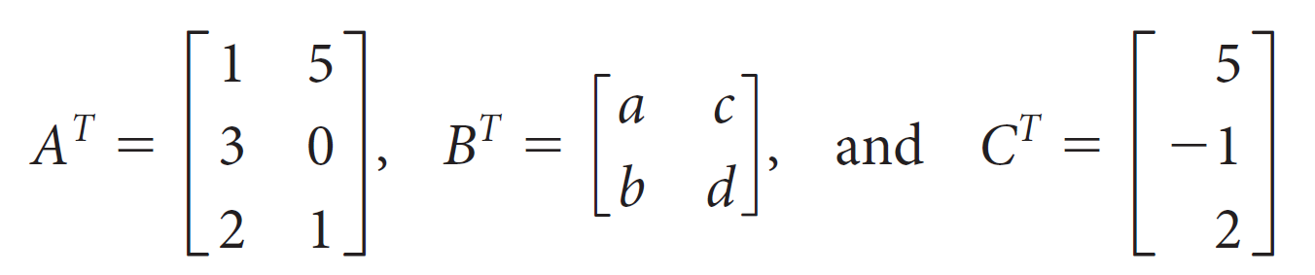
Example 3.14
Let
and C = [5, −1, 2]
Then their transposes are

Slide 48
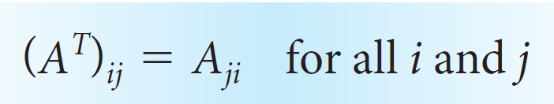
The Transpose of a Matrix (2 of 3)
A useful alternative definition of the transpose is given componentwise:
In words, the entry in row i and column j of
is the same as the entry in row j and column i of A.

Slide 49
The Transpose of a Matrix (3 of 3)
The transpose is also used to define a very important type of square matrix: a symmetric matrix.
Definition
A square matrix A is symmetric if
= A—that is, if A is equal to its own transpose.
A symmetric matrix has the property that it is its own “mirror image” across its main diagonal.
A square matrix A is symmetric if and only if A_{ij} = A_{ji} for all i and j.

